Slide 1
Early Warning Systems for Glacier Lake Outburst Floods:

Slide 2


Introduction to EWS
Early Warning Systems (EWS) for Glacier Lake Outburst Floods (GLOFs) are essential for mitigating risks associated with glacier melt. These systems leverage advanced technologies to monitor changes in glacial lakes and predict potential outburst events, ensuring timely warnings for affected communities.

Slide 3


Understanding GLOFs
Glacier Lake Outburst Floods occur when a dam containing a glacier lake fails, releasing large volumes of water. Understanding the mechanisms and triggers of GLOFs is crucial for developing effective EWS that can save lives and property.

Slide 4

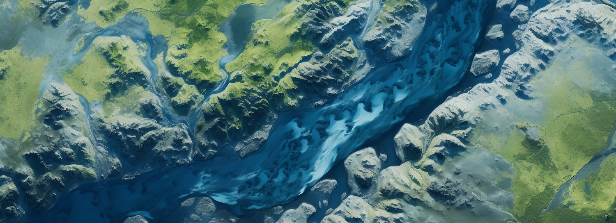
Importance of EWS
The implementation of Early Warning Systems is vital in regions prone to GLOFs. These systems not only provide timely alerts but also enhance community preparedness and resilience against potential disasters, thereby reducing loss of life and property.

Slide 5
Programming for Early Warning

Slide 6
Data Set Description:
The dataset you're working with includes key identifiers and geographical information about glaciers. Each glacier is uniquely identified by a **Glacier ID**, and its location is described by the **Political Unit** (country or administrative region) and **Continent**. The **Basin Code** and **Location Code** provide hydrological context, linking each glacier to specific watersheds and areas. The **Glacier Code** and **Glacier Name** further distinguish each glacier for detailed reference.
The **Latitude** and **Longitude** columns give precise geographic coordinates, which are crucial for mapping and spatial analysis. The **Primary Class** field likely represents the glacier's classification, such as its type or status, which is essential for understanding its characteristics and potential risks, like susceptibility to outburst floods. Overall, this dataset provides comprehensive geographical and classification data necessary for monitoring and analyzing glaciers.
The data set has 1,32,890 rows and 29 columns.

Slide 7
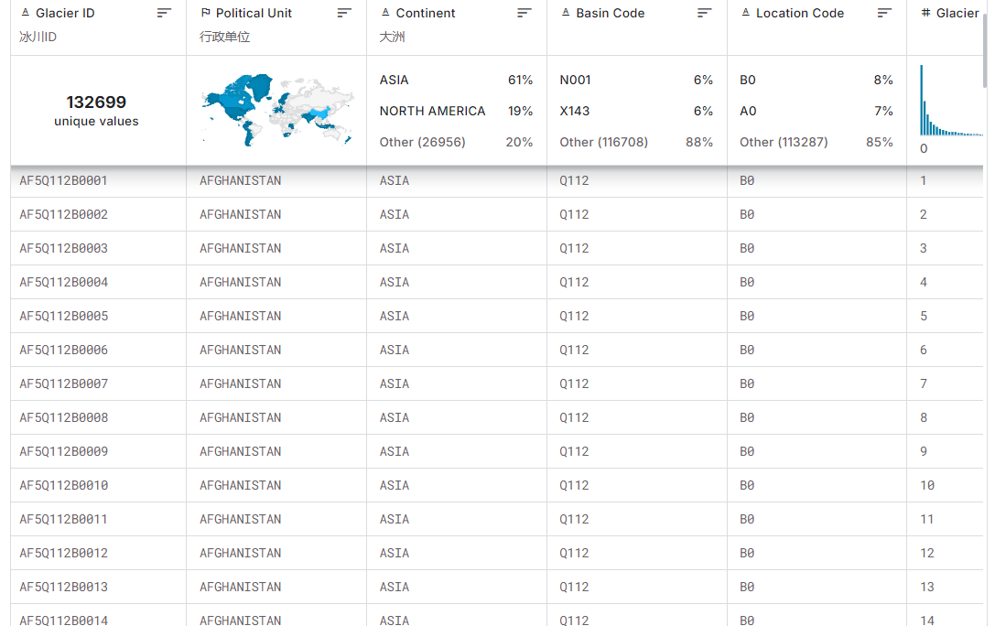

Slide 8
Programming with Random forest Classifier:
I developed an early warning detection system for Glacier Lake Outburst Floods (GLOF) using Python, leveraging the Random Forest Classifier algorithm. This system analyzes satellite data and environmental parameters to predict potential GLOF events. By training the Random Forest model on historical glacier and lake data, it identifies risk factors associated with outbursts, providing timely warnings. The model processes features such as glacier size, lake volume, location, and other critical factors to classify the likelihood of an outburst. This tool can help communities in vulnerable areas by offering early alerts, allowing time for evacuation and preventive measures. With its high accuracy and adaptability, the system contributes to improving disaster preparedness and mitigating the impact of GLOFs.
Made by Dundi

Slide 9
Random Forest Classifier Algorithm:
Random Forest Classification is a powerful machine learning algorithm that operates by creating a collection of decision trees. Each tree is trained on a random subset of the data, and the final prediction is based on the majority vote of all the trees. This ensemble method reduces overfitting and improves accuracy compared to a single decision tree. It is highly effective for handling both numerical and categorical data and is robust against noisy or missing data. Random Forest is widely used for classification tasks because of its versatility, scalability, and ability to handle large datasets with complex relationships.

Slide 10
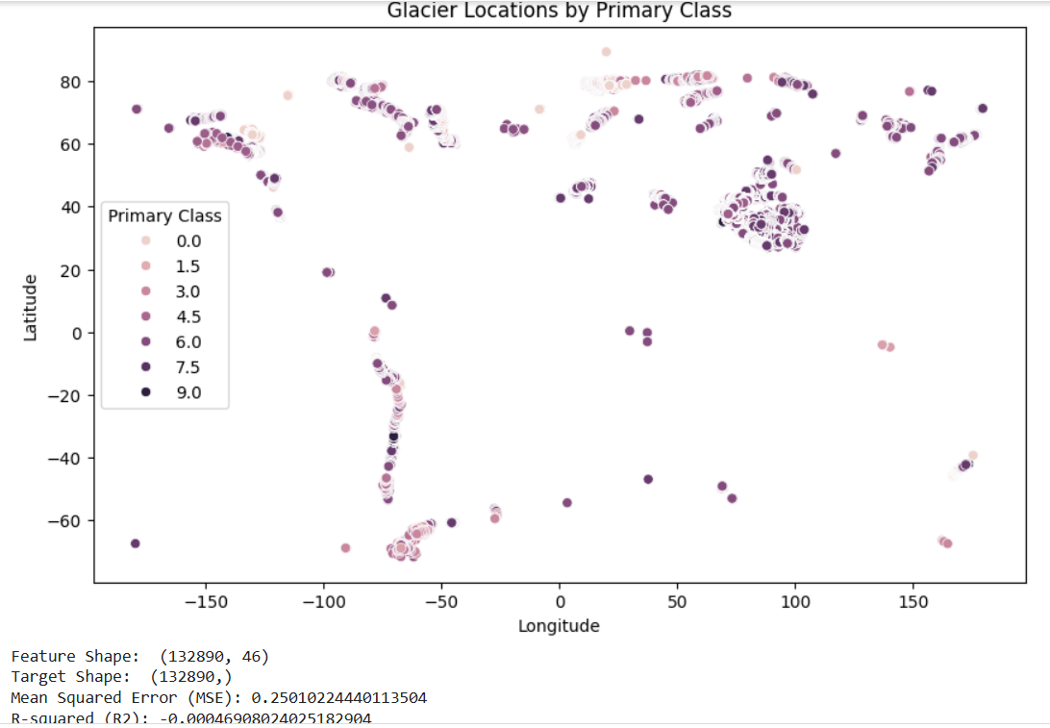

Slide 11
Programming with Logistic Regression:
Developed an early warning detection system for Glacier Lake Outburst Floods (GLOF) using Python, leveraging the Logistic Regression algorithm. This model predicts the likelihood of a GLOF by analyzing key factors such as glacial lake characteristics and geographical data. Logistic Regression, a binary classification algorithm, helps determine the probability of a flood event based on input features, enabling timely alerts. The system can be integrated with real-time monitoring tools, enhancing prediction accuracy. This tool aims to improve disaster preparedness by providing early warnings, helping authorities and communities take preventive measures, and ultimately reducing the risks associated with GLOFs.
Made By T. Sai Sandeep

Slide 12
Logistic Regression Algorithm:
Logistic Regression is a popular machine learning algorithm used for binary classification tasks. It models the relationship between input features and a binary outcome by estimating probabilities using a logistic function (sigmoid curve). Unlike linear regression, logistic regression predicts discrete class labels (e.g., 0 or 1) by converting the continuous output into probabilities. It is particularly useful when the relationship between variables is linear and interpretable, offering coefficients that indicate the importance of each feature. Logistic regression is easy to implement, computationally efficient, and performs well when the data is linearly separable, making it widely used in various domains.

Slide 13
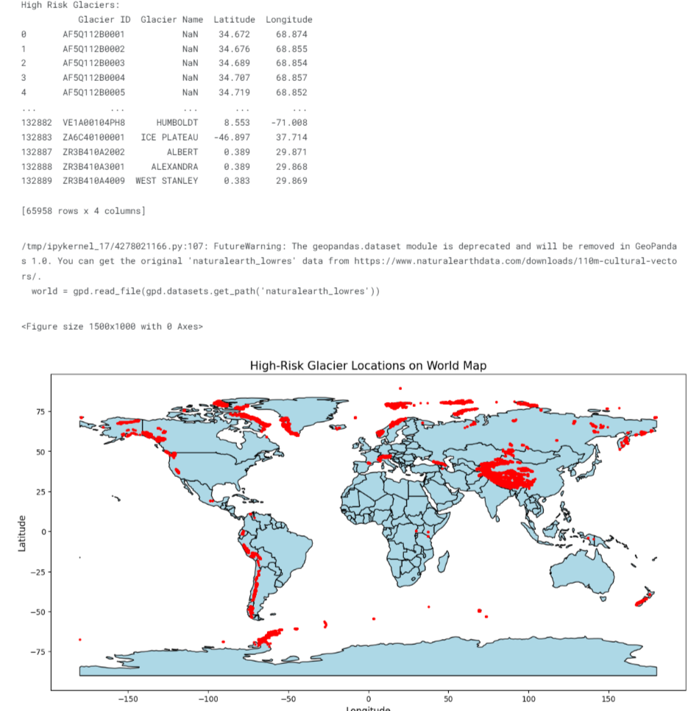

Slide 14
Linear Regression Algorithm:
Linear regression is a fundamental machine learning algorithm used to predict continuous outcomes by modeling the relationship between a dependent variable and one or more independent variables. It assumes that this relationship is linear, meaning the change in the dependent variable is proportional to changes in the independent variables. The model works by fitting a line (or a hyperplane for multiple variables) that minimizes the difference between actual and predicted values, typically using a metric like Mean Squared Error (MSE) to measure accuracy. The algorithm optimizes its parameters, or coefficients, through an iterative process called Gradient Descent, which reduces error by adjusting the coefficients in small steps.

Slide 15
Decision Tree Classifier Algorithm:
The Decision Tree Classifier is a versatile and intuitive machine learning algorithm well-suited for classification tasks, making it an ideal choice for GLOFs (Glacial Lake Outburst Floods) risk prediction. This algorithm operates by constructing a tree-like model of decisions based on the features of the dataset. Each node in the tree represents a feature, and branches represent decision rules that lead to leaf nodes, where classifications are made. By recursively splitting the data based on feature values that best differentiate between classes, the Decision Tree Classifier efficiently learns patterns and classifies outcomes, such as high-risk or low-risk areas in GLOF scenarios.

Slide 16

Future Technologies
Emerging technologies such as artiﬁcial intelligence and machine learning hold great promise for enhancing EWS. These tools can improve predictive modeling and automate data analysis, leading to more accurate and timely warnings.

Slide 17


Thanks!

